Slide 1
Introduction
Emanuele Della Valle
Prof. @ Politecnico di Milano
Founder & Partner @ Quantia Consulting
Marco Balduini
Founder & CEO @ Quantia Consulting
Riccardo Tommasini
Prof. @ INSA Lyon (France)

Slide 2




It's a streaming world …
Off-shore oil operations
Smart Cities
Social networks
E. Della Valle

Slide 3
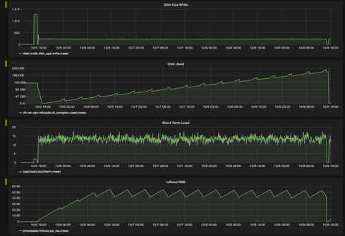
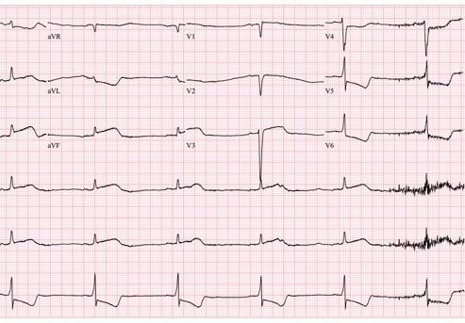
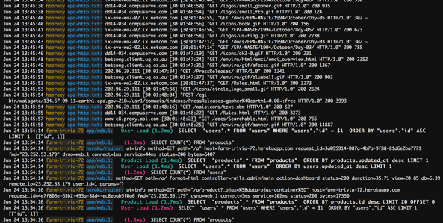
… full of …
E. Della Valle

Slide 4
… full of …
data streams,
E. Della Valle

Slide 5
… full of …
data streams,
time series,
E. Della Valle

Slide 6
… full of …
data streams,
time series,
metrics, and
E. Della Valle

Slide 7
… full of …
data streams,
time series,
metrics, and
events!
E. Della Valle

Slide 8
… looking for historical descriptive analysis …
What is the average time to failure for the different brands of turbine in use?
What is the maximum delay of the public transport per city district?
Which content features are correlated to high impact posts?
E. Della Valle

Slide 9
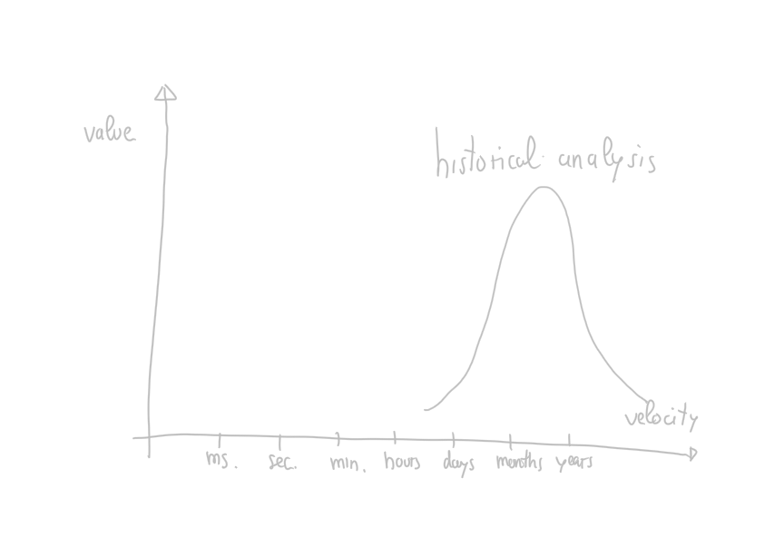

Slide 10
… struggling with prescriptive analysis …
What is the expected time to failure when that turbine starts to vibrate as detected in the last 10 minutes?
Can I get to that meeting in the next 15 min using public transport?
Who is driving the discussion about the top 10 emerging topics?
E. Della Valle

Slide 11
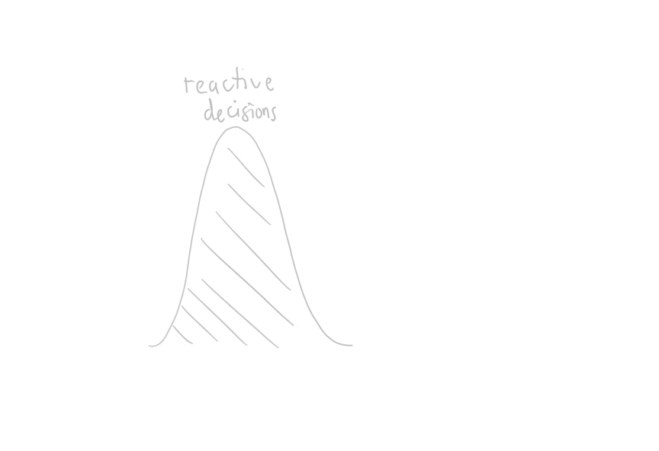

Slide 12

… to act in time

Slide 13
… while taking data-driven decisions
Data
Decision
Action
Data
[src. Gartner]
Machine-centered
Human-Centered

Slide 14
… while taking data-driven decisions
Descriptive
What happen?
Data
Decision
Action
Data
[src. Gartner]
Machine-centered
Human-Centered

Slide 15
… while taking data-driven decisions
Descriptive
What happen?
Diagnostic
Why did it happen?
Data
Decision
Action
Data
[src. Gartner]
Machine-centered
Human-Centered

Slide 16
… while taking data-driven decisions
Descriptive
What happen?
Diagnostic
Why did it happen?
Predictive
What will happen?
Data
Decision
Action
Data
[src. Gartner]
Machine-centered
Human-Centered

Slide 17
… while taking data-driven decisions
Descriptive
What happen?
Diagnostic
Why did it happen?
historical
analysis
Predictive
What will happen?
Data
Decision
Action
Prescriptive
What should I do?
[src. Gartner]
Machine-centered
Human-Centered

Slide 18
… while taking data-driven decisions
Descriptive
What happen?
Diagnostic
Why did it happen?
historical
analysis
Predictive
What will happen?
Data
Decision
Action
Decision Support
Prescriptive
What should I do?
Decision Automation
[src. Gartner]
Machine-centered
Human-Centered

Slide 19
… while taking data-driven decisions
Descriptive
What happen?
Diagnostic
Why did it happen?
historical
analysis
Predictive
What will happen?
Data
Decision
Action
Decision Support
reactive decisions
Prescriptive
What should I do?
Decision Automation
[src. Gartner]
Machine-centered
Human-Centered

Slide 20
Introduction
Emanuele Della Valle
Prof. @ Politecnico di Milano
Founder & Partner @ Quantia Consulting
Marco Balduini
Founder & CEO @ Quantia Consulting
Riccardo Tommasini
Prof. @ INSA Lyon (France)

